Slide 1
Code::Block Help
Compiling and running your multiple c files in the same project folder ( each with main() function)

Slide 2
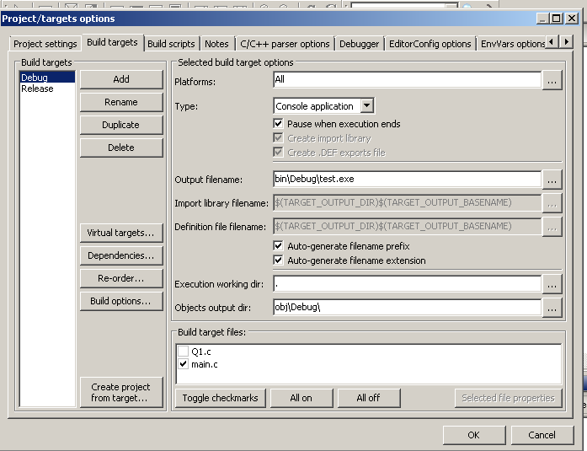
Step 1
Go to Project
-> Properties
-> Build targets
You can see two main files here .

Slide 3
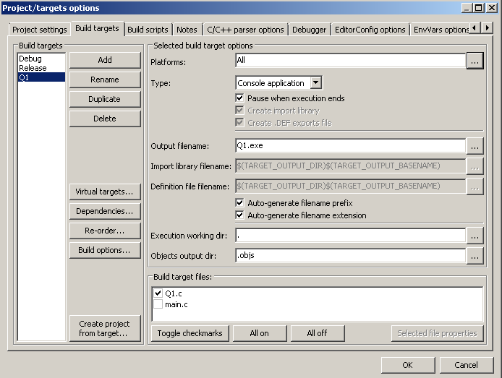
Step 2
Add new target for your C file ( continue the same process each time you add new .c file )
Check all of them

Slide 4
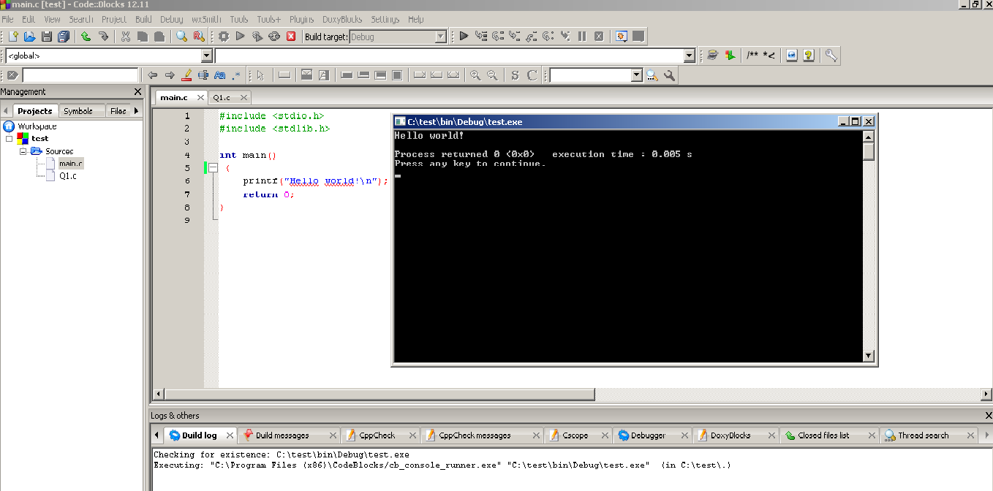
Step 3
Each time you build and run , choose the correct target .

Slide 5
